Slide 1
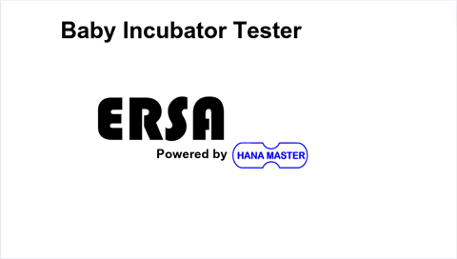

Slide 2
Baby Incubator Tester
Battery
%
14/05/2024 10:45:32
Temperature Monitoring
Air Speed and Sound Level
Setup
Wiring Guide
Temperature Trend
Radiant Warmer
Placement Guide

Slide 3

Baby Incubator Tester
Battery
%
Temperature Monitoring
Air Speed and Sound Level
Setup
Wiring Guide
Temperature Trend
Radiant Warmer
Placement Guide

Slide 4

Baby Incubator Tester
Battery
%
14/05/2024 10:45:32
Temperature (°C)
T1
26.7
T3
27.1
Humidity (%)
Max: 27.2
Max: 27.8
T2
26.9
T4
27.0
56.2
Max: 27.3
Max: 27.9
T3
26.8
T5
26.2
Max: 27.0
Max: 27.0

Slide 5
Baby Incubator Tester
Battery
%
Temperature (°C)
Humidity (%)
T1
T4
Max:
Max:
T2
T5
Max:
Max:
T3
T6
Temperature Trend
Max:
Max:

Slide 6
Baby Incubator Tester
Battery
%
Temperature (°C)
Humidity (%)
T1
T4
Max:
Max:
T2
T5
Max:
Max:
T3
T6
Temperature Trend
Max:
Max:

Slide 7
Baby Incubator Tester
Battery
%
Temperature (°C)
Humidity (%)
T1
T3
Max:
Max:
T2
T4
Max:
Max:
T3
T5
Max:
Max:

Slide 8
Baby Incubator Tester
Battery
%
14/05/2024 10:45:32
Temperature (°C)
26.4°C
26.4°C
Humidity (%)
Max Temp 1: 27.2°C
Max Temp 4: 27.2°C
26.4°C
26.4°C
56.2
Max Temp 2: 27.2°C
Max Temp 5: 27.2°C
26.4°C
26.4°C
Max Temp 3: 27.2°C
Max Temp 6: 27.2°C

Slide 9
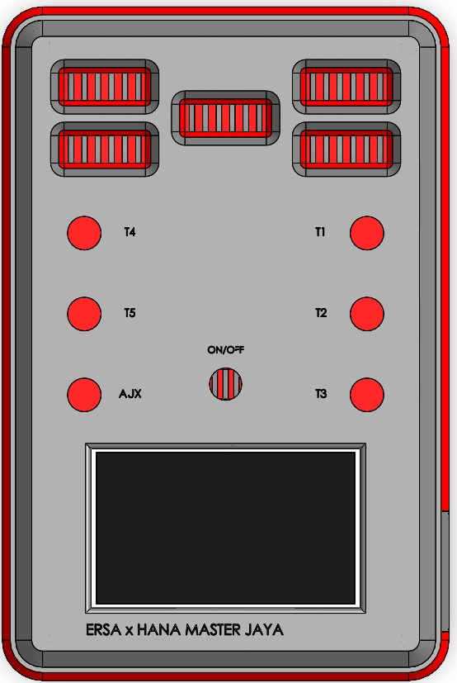
Baby Incubator Tester
Battery
%
Placement Guide
T4
T1
T5
T2
AJX
T3
T1 – T5 = Temperature Sensors
AJX = Air speed and sound level
DC 12V In

Slide 10
Baby Incubator Tester
Battery
%
Placement Guide
T4
T1
T5
T2
AJX
T3
T1 – T5 = Temperature Sensors
AJX = Air speed and sound level
DC 12V In

Slide 11
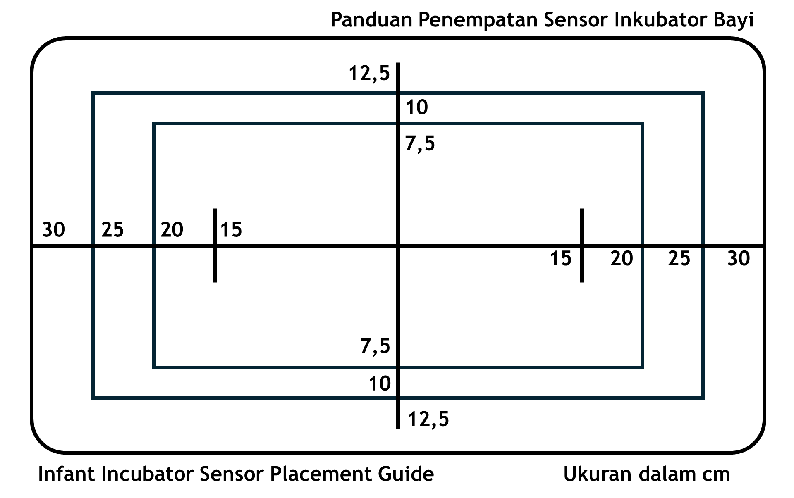
Baby Incubator Tester
Battery
%
Wiring Guide

Slide 12
Baby Incubator Tester
Battery
%
Wiring Guide

Slide 13
Baby Incubator Tester
Battery
%

Slide 14
Baby Incubator Tester
Battery
%

Slide 15
Baby Incubator Tester
Battery
83%
Air Speed (m/s)
Sound Level (dBHL)
1.6
67
Connect air speed sensor and sound level probe to Aux port. Wait 30 sec or restart device if necessary!
Wiring Guide

Slide 16
Baby Incubator Tester
Battery
83%
Air Speed (m/s)
Sound Level (dBHL)
1.6
67
Connect air speed sensor and sound level probe to Aux port. Wait 30 sec or restart device if necessary!
Wiring Guide

Slide 17
Baby Incubator Tester
Battery
%
Air Speed (m/s)
Sound Level (dBHL)
Connect air speed sensor and sound level probe to Aux port. Wait 30 sec or restart device if necessary!
Wiring Guide

Slide 18
Baby Incubator Tester
Battery
%
Air Speed (m/s)
Sound Level (dBHL)
Connect air speed sensor and sound level probe to Aux port. Wait 30 sec or restart device if necessary!
Wiring Guide

Slide 19
Baby Incubator Tester
Battery
%
RADIANT WARMER MODE
Please connect Thermal Absorber sensor to T5!
Disk Temp (°C)
Max Temp (°C)
45
35
25
1m 2m 3m 4m 5m

Slide 20
Baby Incubator Tester
Battery
%
RADIANT WARMER MODE
Please connect Thermal Absorber sensor to T5!
Disk Temp (°C)
Max Temp (°C)
45
35
25
1m 2m 3m 4m 5m

Slide 21
TEMPERATURE TREND
45
35
25
Real-Time (°C)
T1
T2
T3
T4
T5
T6
1m 2m 3m 4m 5m
45
35
25
Clear
Pause
Resolution
1s
2s
4s
8s

Slide 22
TEMPERATURE TREND
45
35
25
Real-Time (°C)
T1
T2
T3
T4
T5
T6
2m 4m 6m 8m 10m
45
35
25
Clear
Pause
Resolution
1s
2s
4s
8s

Slide 23
TEMPERATURE TREND
45
35
25
Real-Time (°C)
T1
T2
T3
T4
T5
T6
4m 8m 12m 16m 20m
45
35
25
Clear
Resume
Resolution
1s
2s
4s
8s

Slide 24
TEMPERATURE TREND
45
35
25
Real-Time (°C)
T1
T2
T3
T4
T5
T6
8m 16m 24m 32m 40m
45
35
25
Clear
Resume
Resolution
1s
2s
4s
8s

Slide 26
Temperature trend will be cleared.
No data saved. Are you sure?
Yes
No

Slide 27
Temperature trend will be cleared.
No data saved. Are you sure?
Yes
No

Slide 28
Baby Incubator Tester
Battery
%
BRIGHTNESS
%
DATE AND TIME SETTINGS
/ /
Change
: :

Slide 29
Baby Incubator Tester
Battery
%
BRIGHTNESS
%
DATE AND TIME SETTINGS
/ /
<
>
Set
: :
+
-

Slide 30
Baby Incubator Tester
Battery
%
BRIGHTNESS
%
DATE AND TIME SETTINGS
/ /
<
>
Set
: :
+
-

Slide 31
Panduan Penempatan Sensor Inkubator Bayi
12,5
10
7,5
30
25
20
15
15
20
25
30
7,5
10
12,5
Infant Incubator Sensor Placement Guide
Ukuran dalam cm

Slide 32
Baby Incubator Tester
Battery
%
Data Stream Only
Data Capture and Stream

Slide 33
Baby Incubator Tester
Battery
%
Data Stream Only
Data Capture and Stream

Slide 34
Baby Incubator Tester
Battery
%
File Name
Back
Save

Slide 35
Baby Incubator Tester
Battery
%
File Name
Back
Save

Slide 36
Baby Incubator Tester
Battery
%
File Name
File created!
Back
Save

Slide 37






TEMPERATURE TREND
Real-Time
T1
T2
T3
T4
T5
T6
$$°\text{C}$$
$$°\text{C}$$
$$°\text{C}$$
$$°\text{C}$$
$$°\text{C}$$
$$°\text{C}$$
Clear
Pause
Start Capture
Res
1s
2s
4s
8s

Slide 38
TEMPERATURE TREND
Real-Time
T1
T2
T3
T4
T5
T6
$$°\text{C}$$
$$°\text{C}$$
$$°\text{C}$$
$$°\text{C}$$
$$°\text{C}$$
$$°\text{C}$$
Clear
Pause
Start Capture
Res
1s
2s
4s
8s

Slide 39
TEMPERATURE TREND
Writing to
Real-Time
T1
T2
T3
T4
T5
T6
$$°\text{C}$$
$$°\text{C}$$
$$°\text{C}$$
$$°\text{C}$$
$$°\text{C}$$
$$°\text{C}$$
Clear
Resume
Stop and Save
Res
1s
2s
4s
8s

Slide 40
TEMPERATURE TREND
Real-Time
T1
T2
T3
T4
T5
T6
$$°\text{C}$$
$$°\text{C}$$
$$°\text{C}$$
$$°\text{C}$$
$$°\text{C}$$
$$°\text{C}$$
Clear
Resume
Stop and Save
Res
1s
2s
4s
8s

